Slide 1
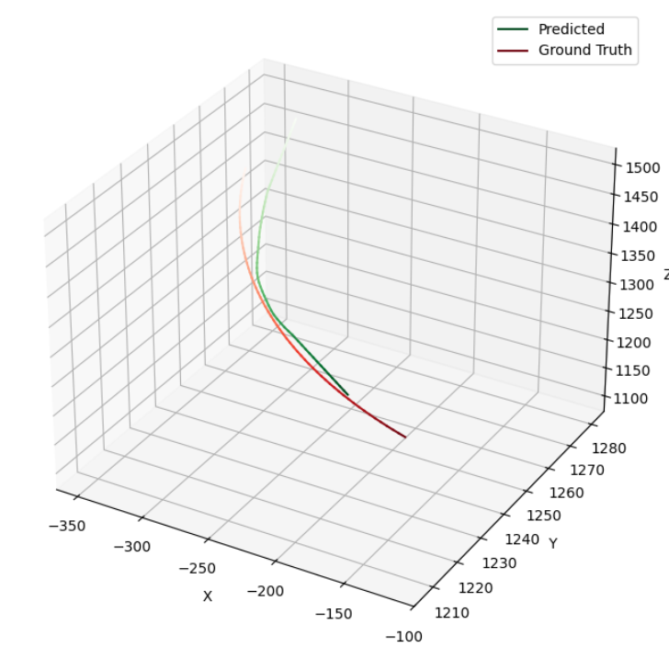
Problem Statement
Pain (+Gain)
Drone vs Drone fights happen very often.
It is aimed to beat the more expensive drone with cheaper drone.
Currently, drones are controlled manually.
Identifed the industrial needs.
An AI model is developed that predicts coordinates of enemy in next 3 seconds timeframe with aprx. 200 meters error.
Scope
Product Demo
Jet vs Jet
Identify enemy
Dog-fight
Predict enemy trajectory
Drone
vs
Drone
Optimize policy
Pursuit
Shot/Hit
Uniqueness
A foundational architecture that enables faster adaptation to different tasks.

Slide 2
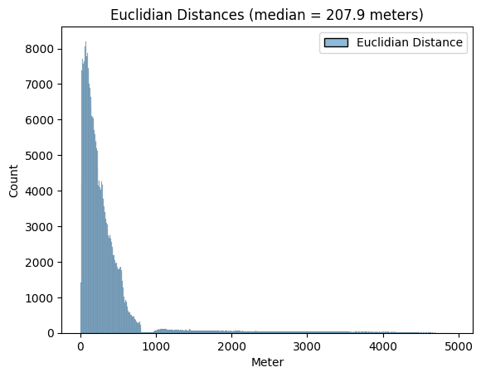
Error Distribution

